Slide 1
Understand Pandemic Inflation
Team:
Harsha Vardhan - ht394
Ajinkya Phase -
Sajeev Singh
Heamesh

Slide 2
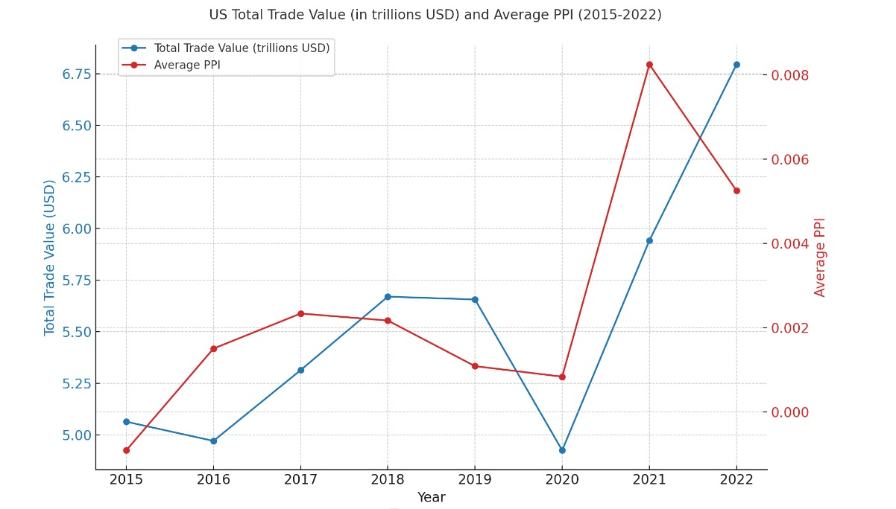
Dip In Global Trade, Impact on Inflation
Initial Hypothesis: Due to a significant halt in imports, manufacturing faced substantial disruptions, leading to a widespread increase in prices.
Conclusion: Further investigation revealed that while the halt in imports is just one of the factor, there are other significant factors involved.
So what caused Inflation?

Slide 3
Inflation
What is Inflation?
Inflation is the increase in the prices of goods and services over time. It is usually measured as an annual percentage increase.
CPI: Consumer Price Index
PPI: Producer price Index
Causes of Inflation
Core + Headline
Core: Increase in price changes, excluding volatile categories such as food and energy prices
Headline: Increase in price changes, including all goods and services.

Slide 4
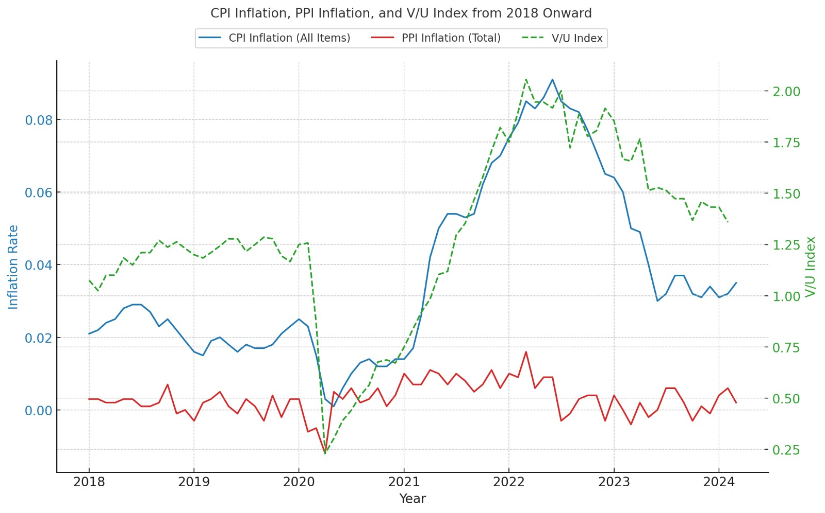
Pandemic Inflation Story
It is believed that inflation is driven by rising prices in energy, housing, and all other goods and services. - These are derived but not driving factors
Causal factor for Core Inflation:
V/U Index
V/U = % of Job vacancies / % of Unemployment

Slide 5
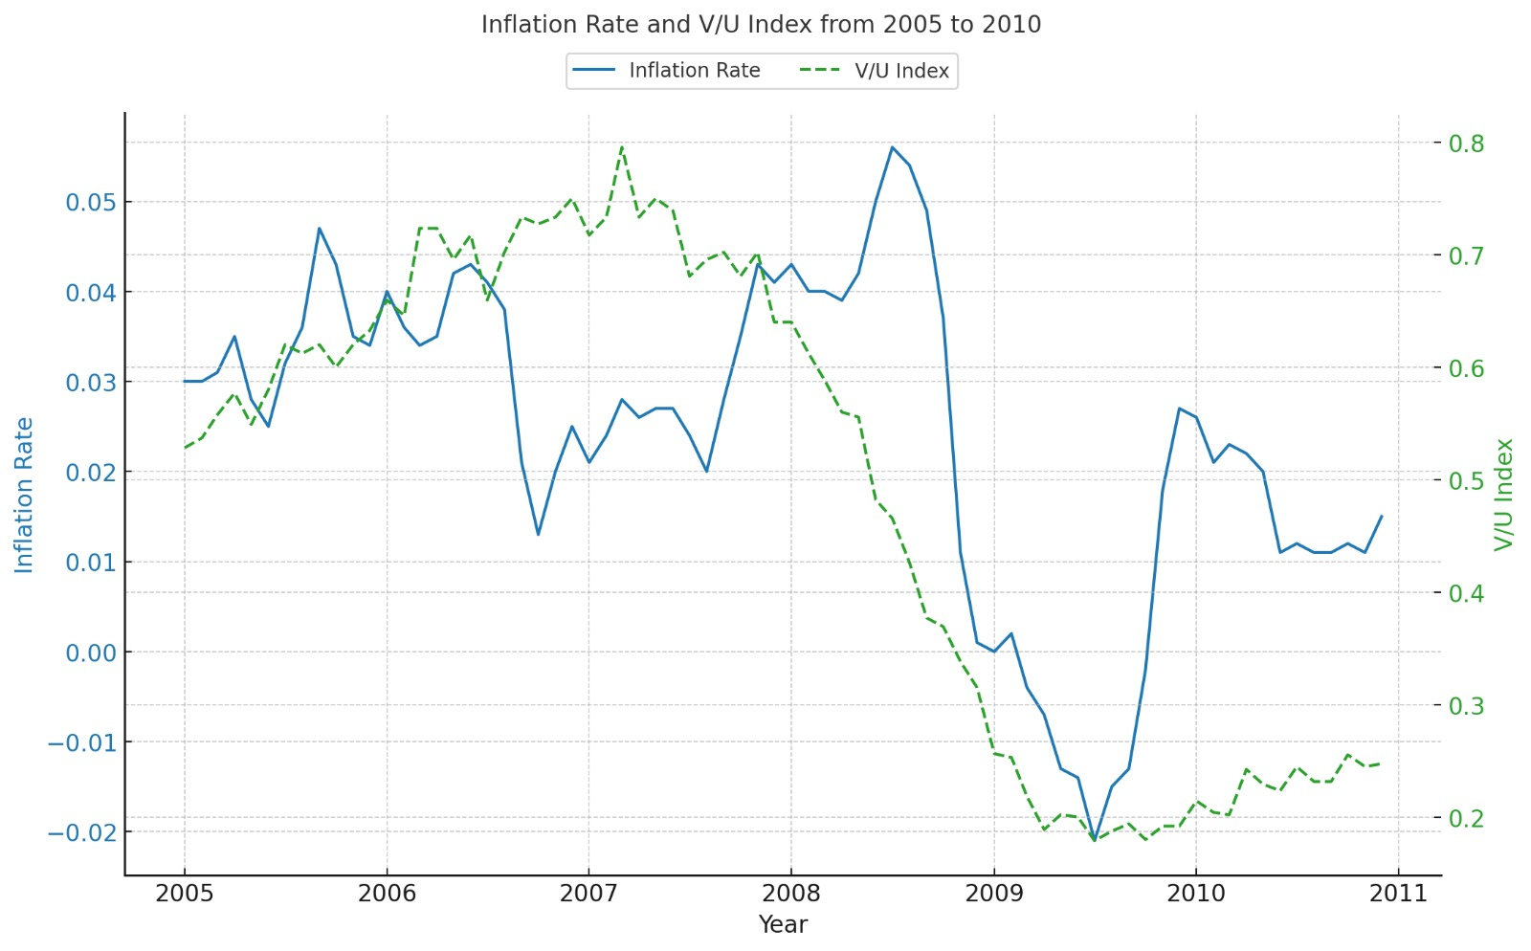
How is it different from 2007 Inflation

Slide 6
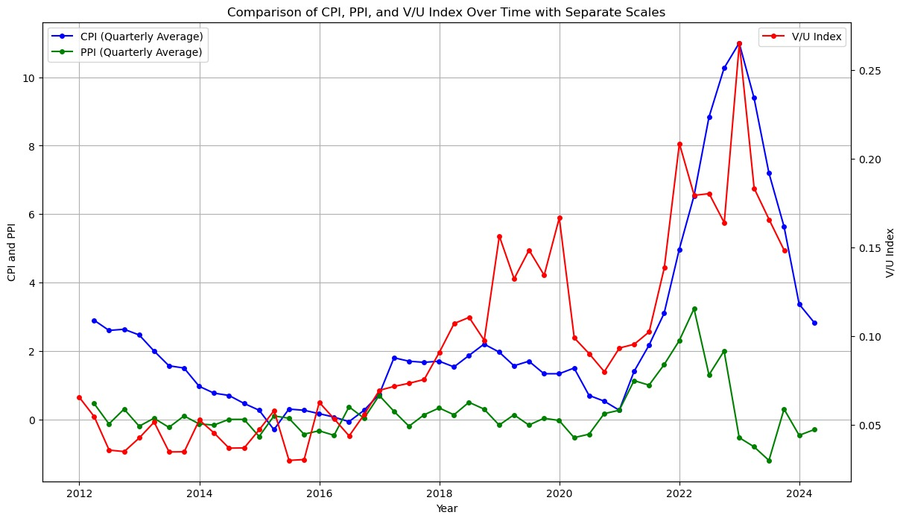
Europe’s Inflation

Slide 7
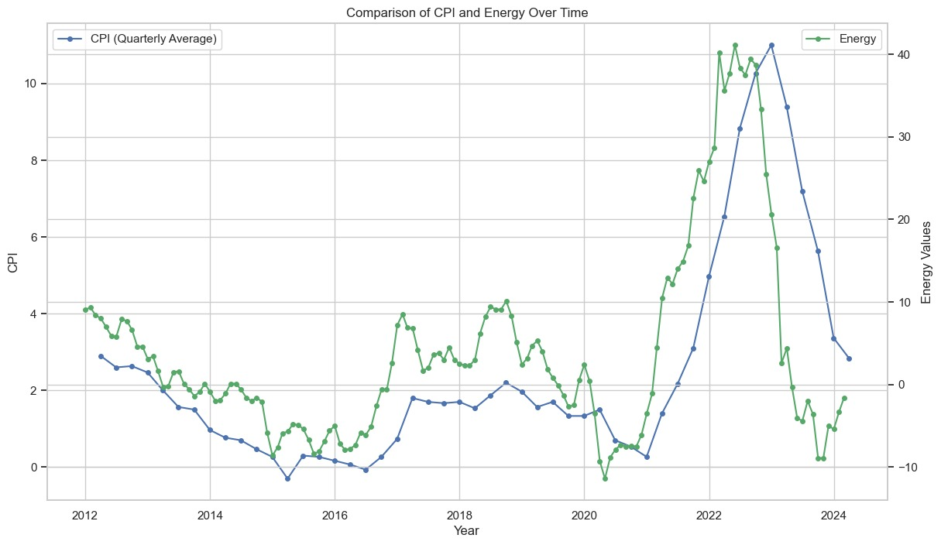
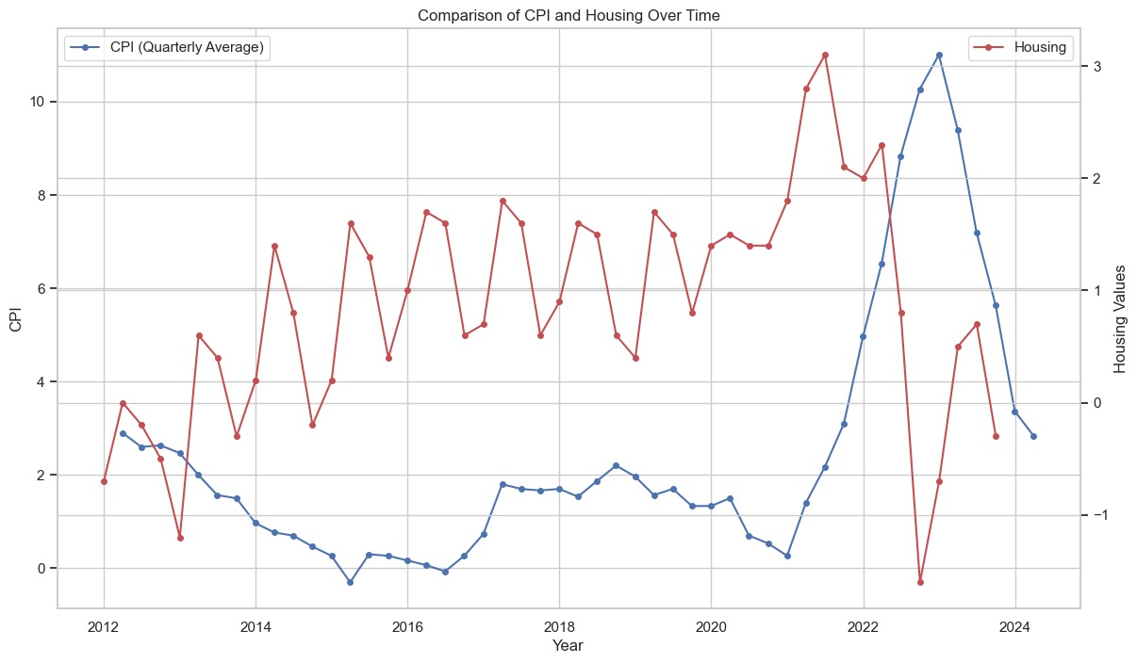
Europe’s Headline Effects

Slide 8
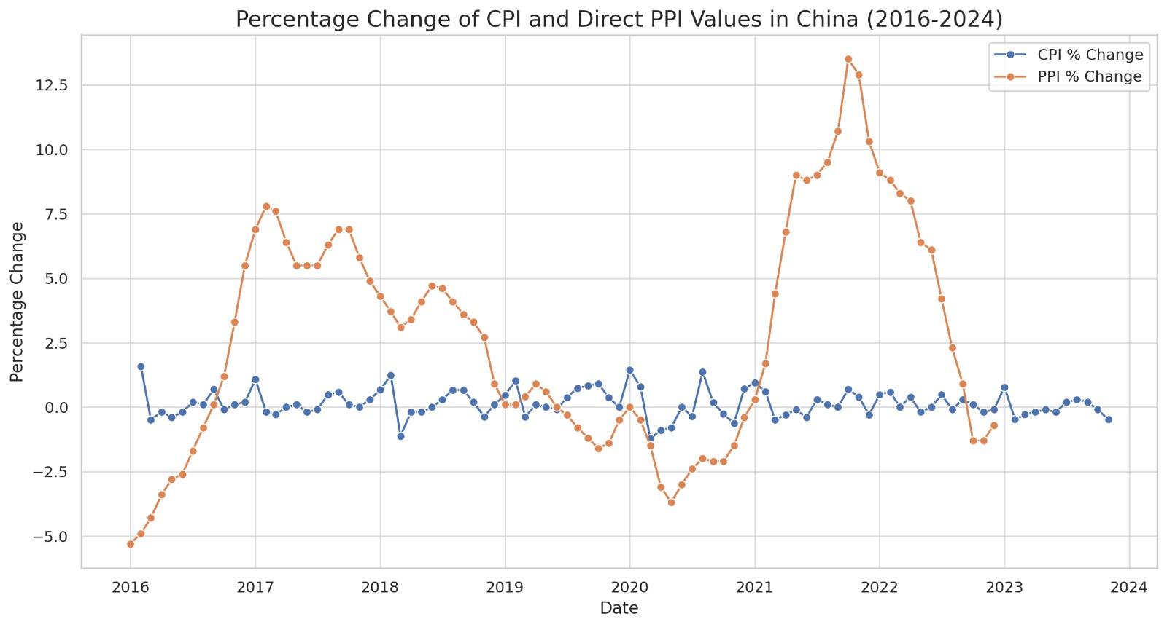
China’s Inflation

Slide 9
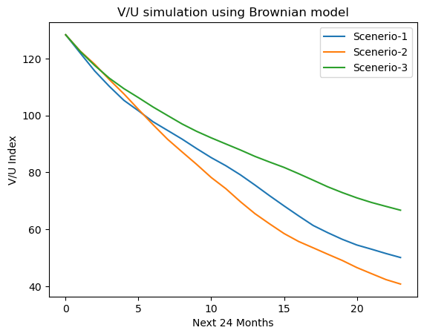
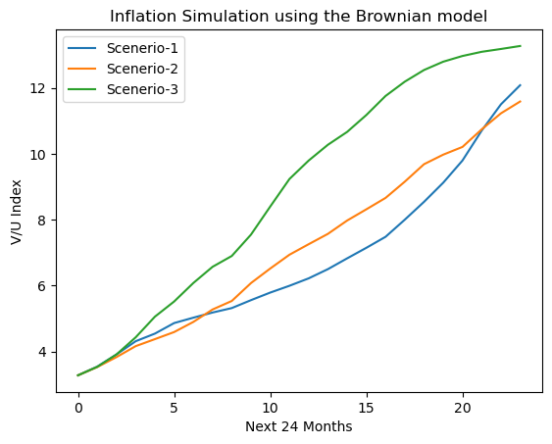
Forecast
V/U forecast
Assuming no further FED actions are taken
Inflation forecast
Fixed on V/U index-136 & No further FED actions

Slide 10
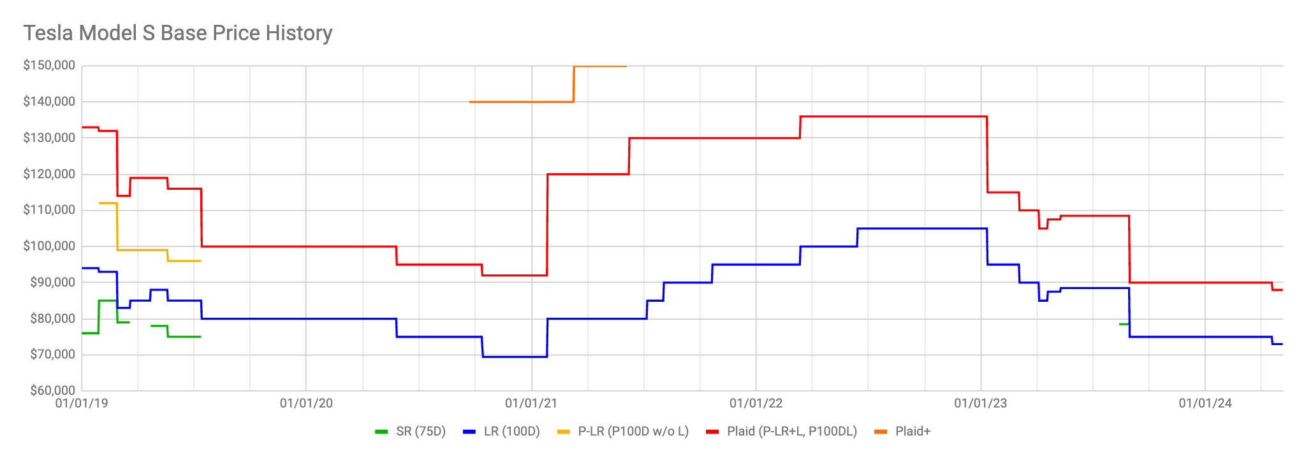
Tesla Case Study
Model S price changes over years

Slide 11
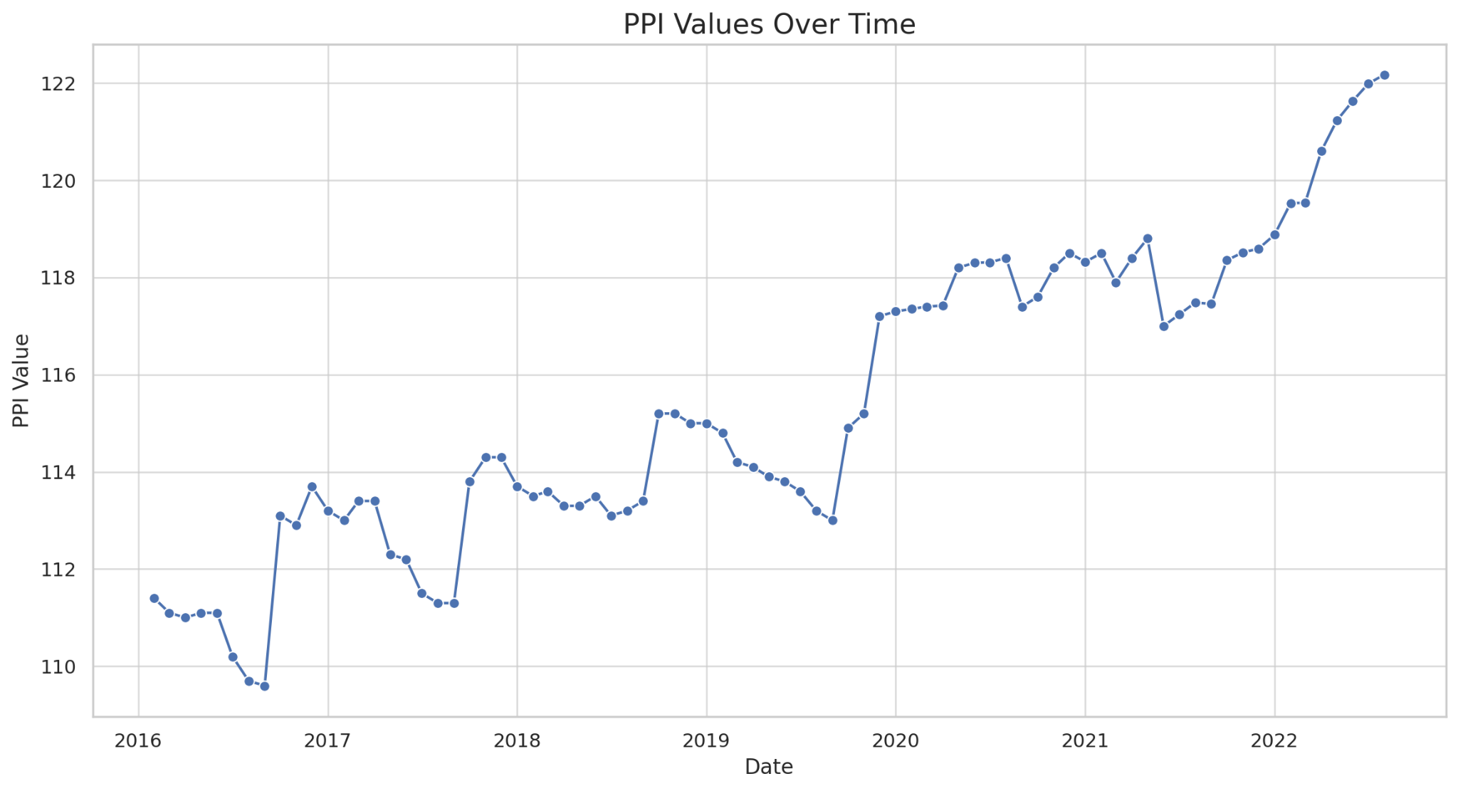
Motor Vehicle Industry PPI

Slide 12
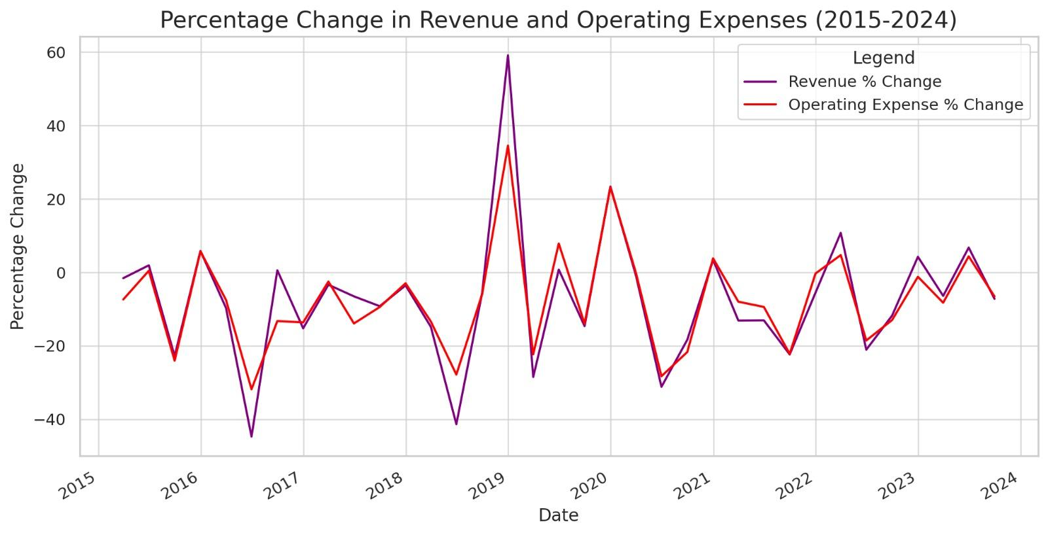
Operational expenses & Revenue percentage change over years

Slide 13
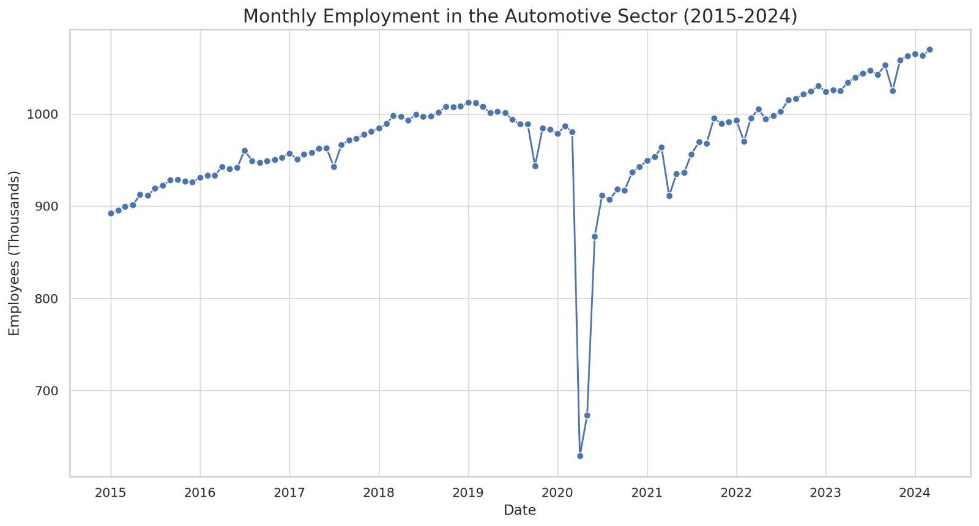
Employment in automotive sector over the years

Slide 14
Thank you

